Slide 1
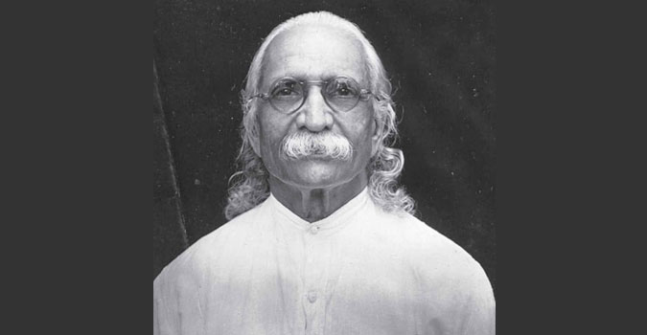
Swami Kuvalayananda
Dr. Brijesh Singh

Slide 2
Swami Kuvalayananda (30 August 1883 – 18 April 1966) was a researcher and educator who is primarily known for his pioneering research into the scientific foundations of yoga. He started scientific research on yoga in 1920, and published the first scientific journal specifically devoted to studying yoga, Yoga Mimamsa, in 1924. Most of his research took place at the Kaivalyadhama Health and Yoga Research Center which he also founded in 1924. His influence on modern yoga has been “profound”.

Slide 3
1883 - 1916
Early Life
Swami Kuvalayananda was born Jagannatha Ganesa Gune.
During his student days, he was influenced by political leaders like Sri Aurobindo, who was working as a young lecturer at the university, and Lokmanya Tilak’s Indian Home Rule Movement. His national idealism and patriotic fervor prompted him to devote his life to the service of humanity.
Coming into contact with the Indian masses, many of whom were illiterate and superstitious, he realized the value of education, and this influenced him to help organize the Khandesh Education Society at Amalner, where ultimately he became the Principal of the National College, in 1916

Slide 4
1919
Initiation into Yoga
Kuvalayananda’s first guru was Rajaratna Manikrao, a professor at the Jummadada Vyayamshala in Baroda. From 1907 to 1910, Manikrao trained Kuvalayananda in the Indian System of Physical Education.
In 1919, he met the Bengali yogin, Paramahamsa Madhavdasji, who blessed Kuvalayananda with insights into advanced yogic discipline.
Though Kuvalayananda was spiritually inclined and idealistic, he was, at the same time, a strict rationalist. So, he sought scientific explanations for the various psychophysical effects of Yoga he experienced. The idea of discovering the scientific basis behind these yogic processes became his life’s work.

Slide 5
Establishing Kaivalyadhama and Yoga Mimamsa
In 1924, Kuvalayananda founded the Kaivalyadhama Health and Yoga Research Center in Lonavla in order to provide a laboratory for his scientific study of Yoga. At the same time, he also started the first scientific journal devoted to scientific investigation into yoga, Yoga Mimamsa.

Slide 6
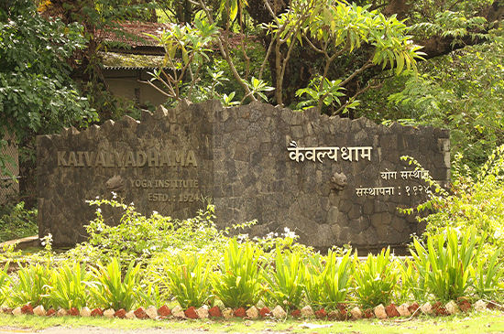
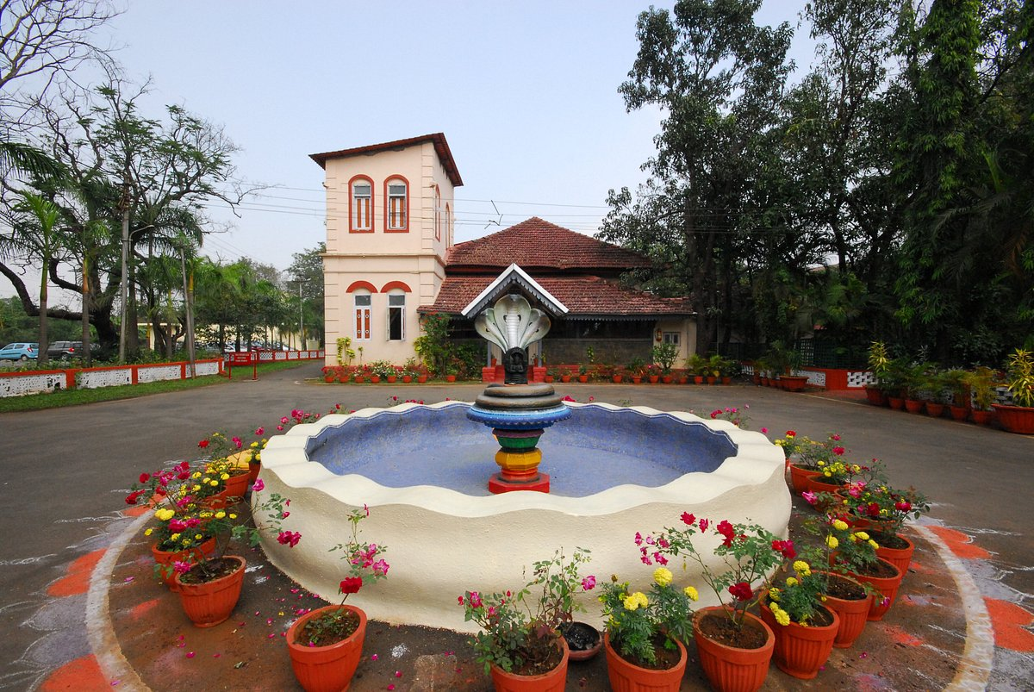
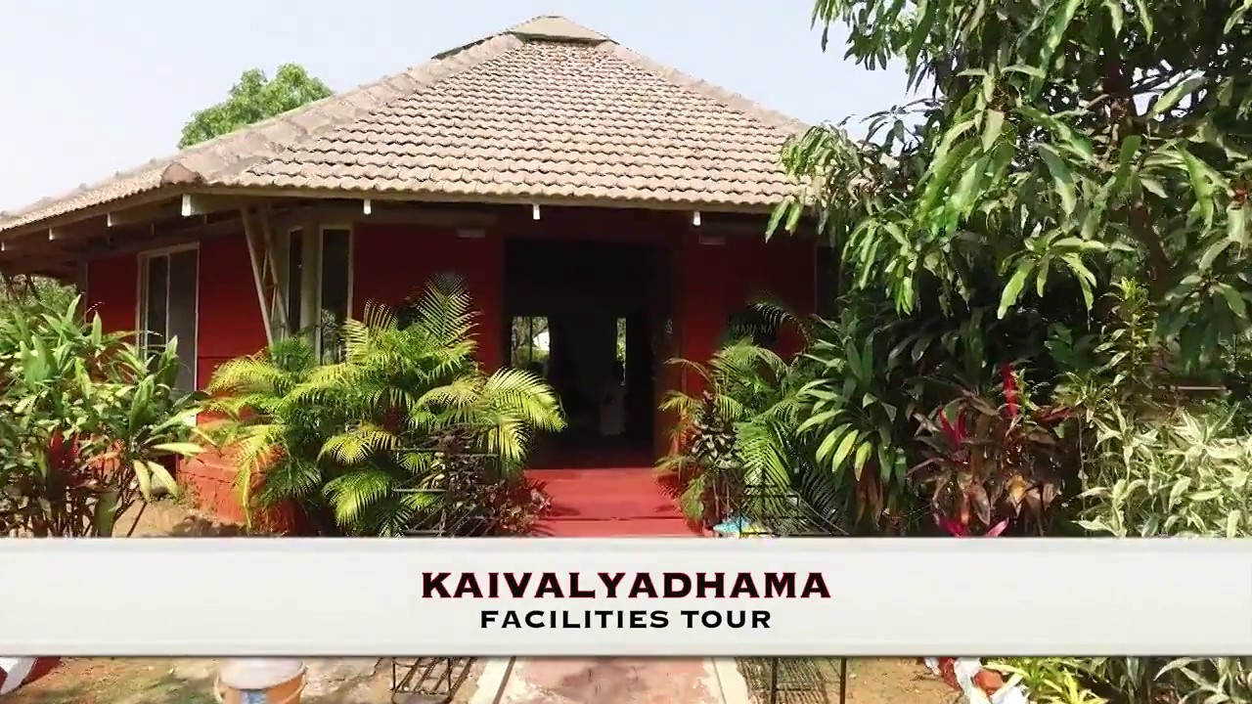

Slide 7
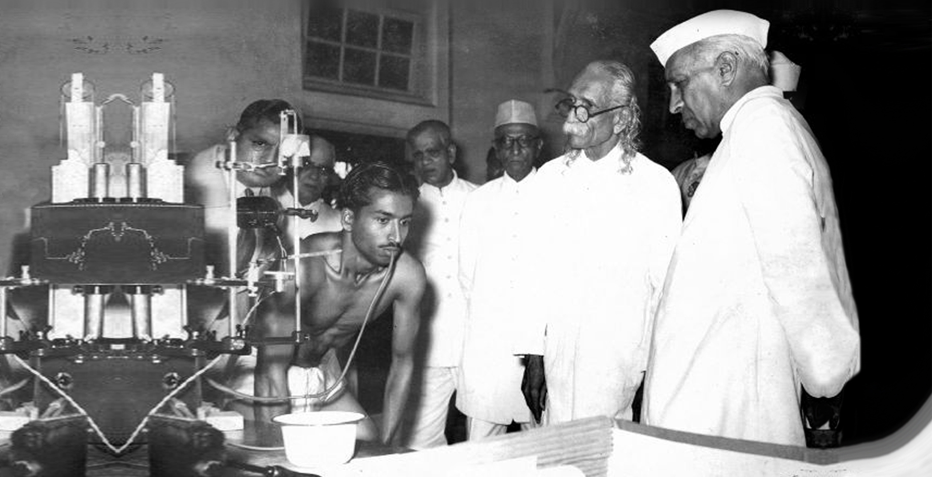
Yoga Research on Cleansing Semi Experimental

Slide 8
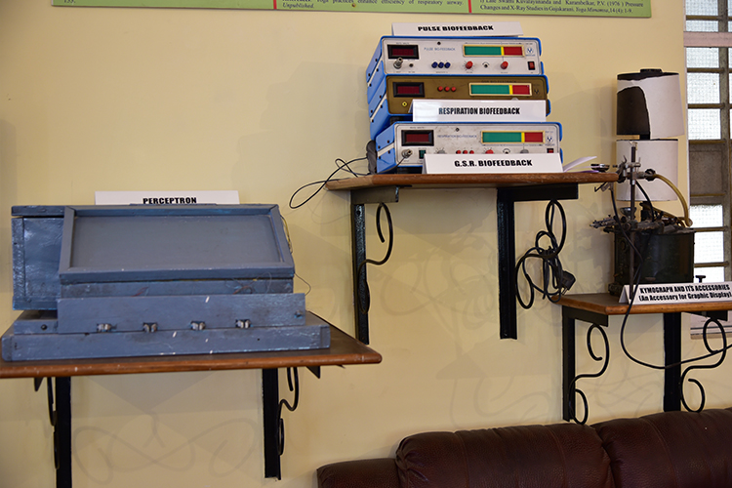
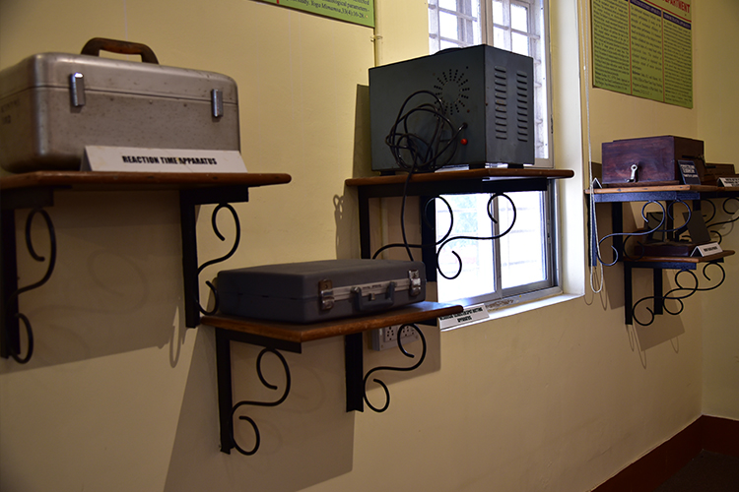
Research Laboratory

Slide 9
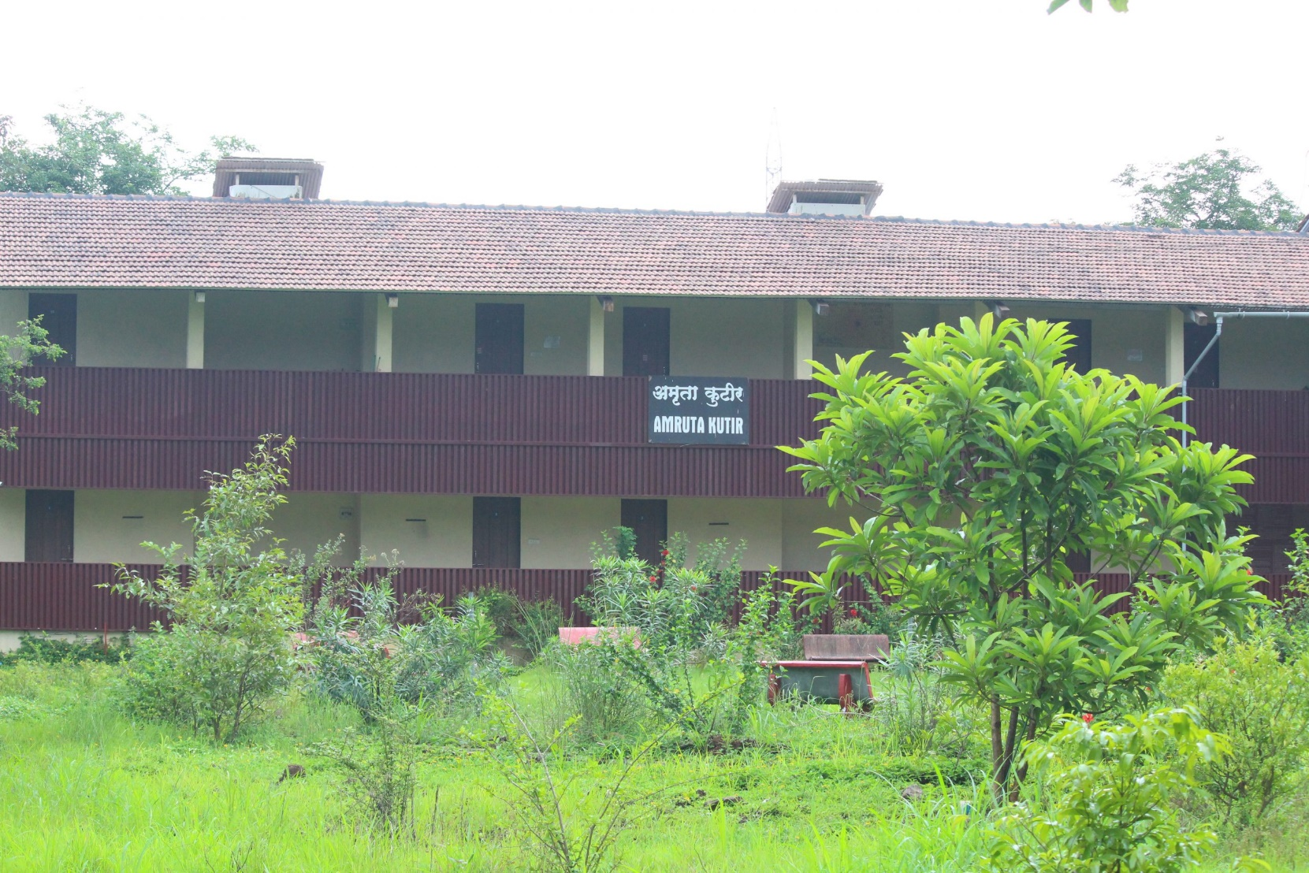
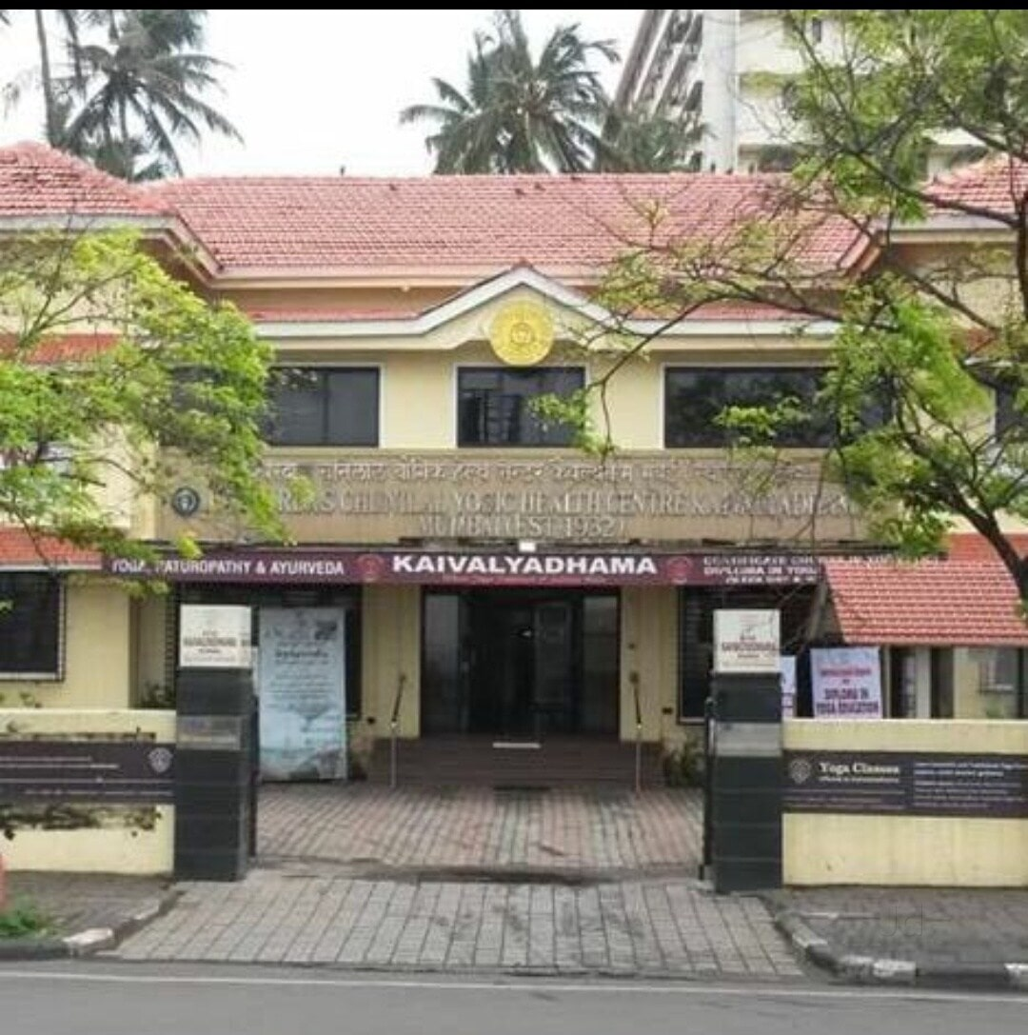
Campus

Slide 10
Later Years..
Besides his yoga research, Swami Kuvalayananda spent much of his later years opening up new branches of Kaivalyadhama and enhancing the main Kaivalyadhama campus in Lonavla.
Mumbai and Rajkot branches were formed and the College of Yoga and a Yogic hospital were started.

Slide 11
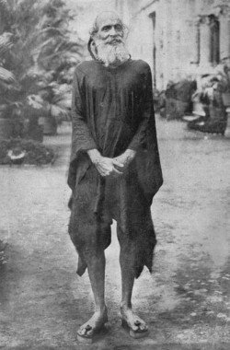
Paramahansa Sri Madhavadasji Maharaj (1798 – 1921) was a great Master of Yoga from Bengal, who after 50 years of traveling India by foot and practicing yoga in the solitude of the Himalayas, had settled, at the age of 80, to begin teaching.

Slide 12
Paramahansa Madhavadasji was a major advocate for the revival of yogic practices, which had almost died out in much of India at that time. He encouraged Swamiji to scientifically investigate the effects and benefits of Yoga practices, for the propagation of health, and spiritual inspiration of all humanity.
In response to his Teacher’s request, Swami Kuvalayananda went on to establish the Kaivalyadhama Institute. Established in 1924 it was the first Yoga Institute of its kind in India, and continues to be a premier center for the medical and scientific study of Hatha Yoga, as well as a resource of ancient texts, teachings, training and yoga therapy.

Slide 13
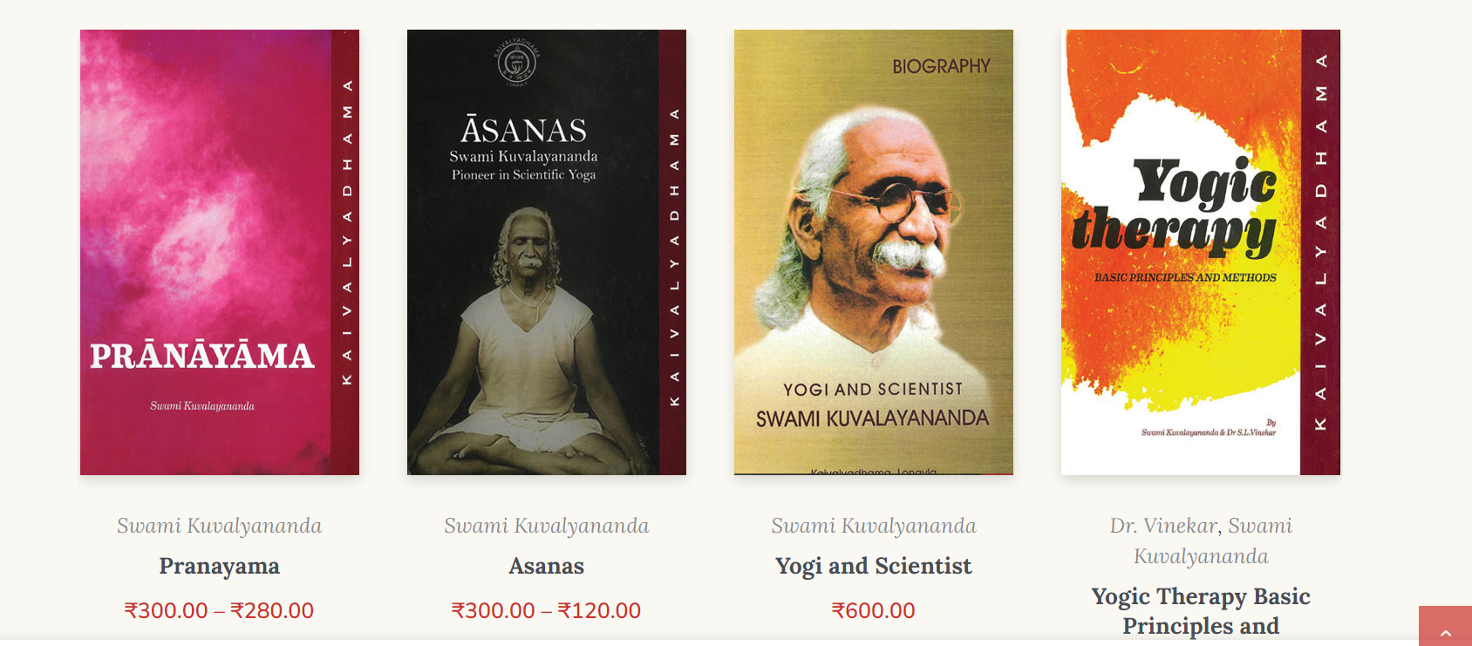
Publication

Slide 14


Slide 15
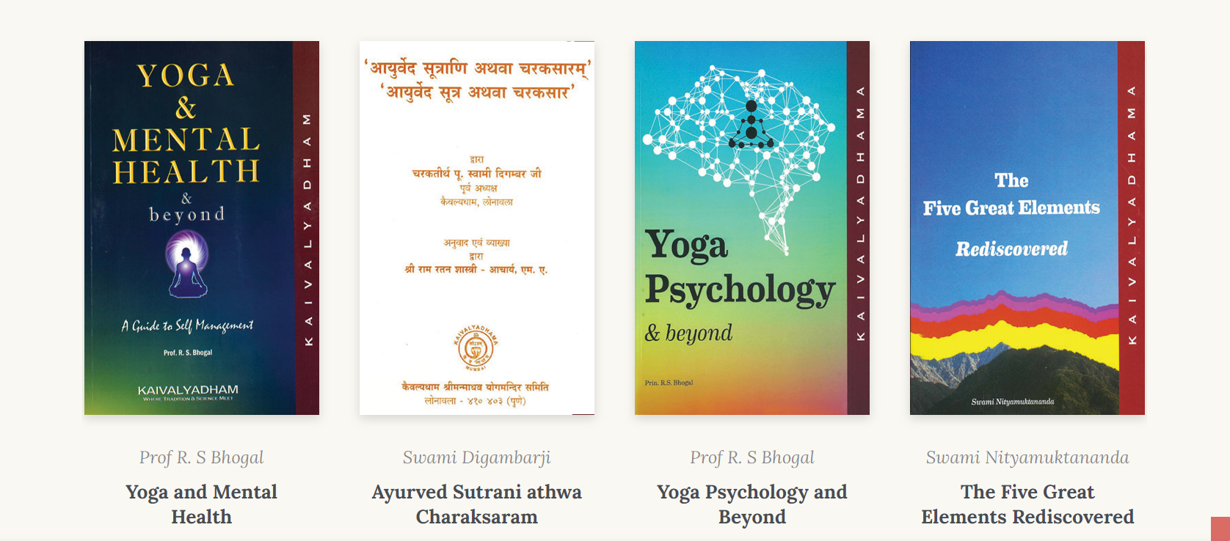

Slide 16
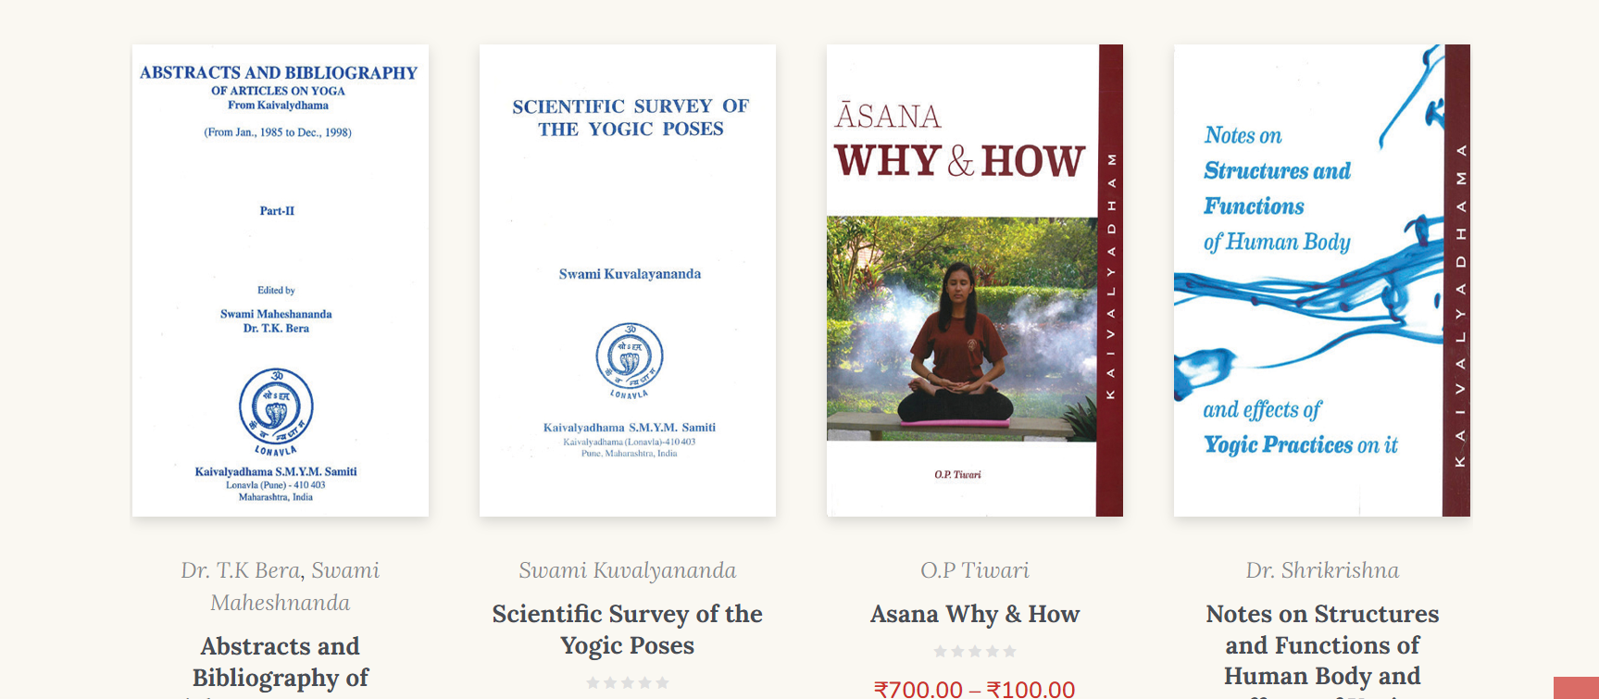

Slide 17


